Slide 1
MICROPROGRAMMED CONTROL
Control Memory
Sequencing Microinstructions
Microprogram Example
Design of Control Unit
Microinstruction Format
Nanostorage and Nanoprogram

Slide 2
COMPARISON OF CONTROL UNIT IMPLEMENTATIONS
Implementation of Control Unit
Control Unit Implementation
Combinational Logic Circuits (Hard-wired)‏
Control Data
Memory
I R
Status F/Fs
Control Unit's State
Timing State
Combinational
Control
Logic Circuits
Points
CPU
Ins. Cycle State
Microprogram
M
Control Data
e
m
Status F/Fs
o
I R
r
y
C
Control
C
C
Next Address
S
Storage
S
D
P
CPU
Generation
A
(μ-program
D
s
Logic
R
memory)‏
R
}

Slide 3
TERMINOLOGY
Microprogram
- Program stored in memory that generates all the control signals required
to execute the instruction set correctly
- Consists of microinstructions
Microinstruction
- Contains a control word and a sequencing word
Control Word - All the control information required for one clock cycle
Sequencing Word - Information needed to decide
the next microinstruction address
- Vocabulary to write a microprogram
Control Memory(Control Storage: CS)‏
- Storage in the microprogrammed control unit to store the microprogram
Writeable Control Memory(Writeable Control Storage:WCS)‏
- CS whose contents can be modified
-> Allows the microprogram can be changed
-> Instruction set can be changed or modified
Dynamic Microprogramming
- Computer system whose control unit is implemented with
a microprogram in WCS
- Microprogram can be changed by a systems programmer or a user

Slide 4
TERMINOLOGY
Sequencer (Microprogram Sequencer)‏
A Microprogram Control Unit that determines
the Microinstruction Address to be executed
in the next clock cycle
- In-line Sequencing
- Branch
- Conditional Branch
- Subroutine
- Loop
- Instruction OP-code mapping

Slide 5
MICROINSTRUCTION SEQUENCING
Sequencing
Instruction code
Mapping
logic
Status
bits
Branch
MUX
Multiplexers
logic
select
Subroutine
register
(SBR)‏
Control address register
(CAR)‏
Incrementer
Control memory (ROM)‏
select a status
bit
Branch address
Microoperations
Sequencing Capabilities Required in a Control Storage
- Incrementing of the control address register
- Unconditional and conditional branches
- A mapping process from the bits of the machine
instruction to an address for control memory
- A facility for subroutine call and return

Slide 6
CONDITIONAL BRANCH
Sequencing
Load address
Control address register
Increment
MUX
Control memory
...
Status
(condition)‏
bits
Condition select
Micro-operations
Next address
Conditional Branch
If Condition is true, then Branch (address from
the next address field of the current microinstruction)‏
else Fall Through
Conditions to Test: O(overflow), N(negative),
Z(zero), C(carry), etc.
Unconditional Branch
Fixing the value of one status bit at the input of the multiplexer to 1

Slide 7
MAPPING OF INSTRUCTIONS TO MICROROUTINES
Sequencing
Mapping from the OP-code of an instruction to the
address of the Microinstruction which is the starting
microinstruction of its execution microprogram
Machine
Instruction
OP-code
1 0 1 1 Address
Mapping bits
0 x x x x 0 0
0 1 0 1 1 0 0
Microinstruction
address
Mapping function implemented by ROM or PLA
OP-code
Mapping memory
(ROM or PLA)‏
Control address register
Control Memory

Slide 8
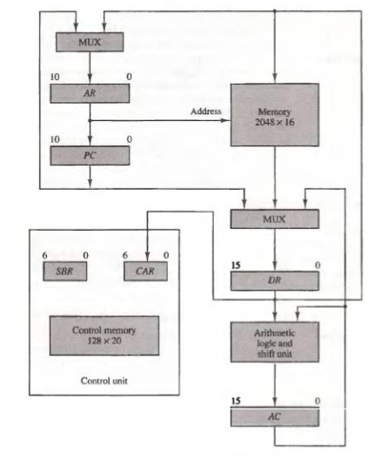
MICROPROGRAM EXAMPLE
Microprogram
Computer Configuration

Slide 9
MACHINE INSTRUCTION FORMAT
Microprogram
Machine instruction format
15
14
11
10
0
I
Opcode
Address
Sample machine instructions
Symbol OP-code Description
EA is the effective address
ADD 0000 AC ← AC + M[EA]
BRANCH 0001 if (AC < 0) then (PC ← EA)‏
STORE 0010 M[EA] ← AC
EXCHANGE 0011 AC ← M[EA], M[EA] ← AC
Microinstruction Format
3
3
3
2
2
7
F1
F2
F3
CD
BR
AD
F1, F2, F3: Microoperation fields
CD: Condition for branching
BR: Branch field
AD: Address field

Slide 10
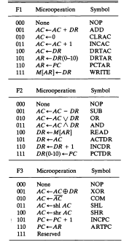
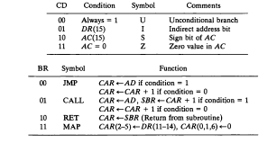

Slide 11
SYMBOLIC MICROINSTRUCTIONS
Microprogram
Symbols are used in microinstructions as in assembly language
A symbolic microprogram can be translated into its binary equivalent by a microprogram assembler.
Sample Format
five fields: label; micro-ops; CD; BR; AD
Label: may be empty or may specify a symbolic address terminated with a colon
Micro-ops: consists of one, two, or three symbols
separated by commas
CD: one of {U, I, S, Z}, where U: Unconditional Branch
I: Indirect address bit
S: Sign of AC
Z: Zero value in AC
BR: one of {JMP, CALL, RET, MAP}
AD: one of {Symbolic address, NEXT, empty}

Slide 12
SYMBOLIC MICROPROGRAM - FETCH ROUTINE
Microprogram
During FETCH, Read an instruction from memory
and decode the instruction and update PC
Sequence of microoperations in the fetch cycle:
AR ← PC
DR ← M[AR], PC ← PC + 1
AR ← DR(0-10), CAR(2-5) ← DR(11-14), CAR(0,1,6) ← 0
Symbolic microprogram for the fetch cycle:
FETCH:
ORG 64
PCTAR U JMP NEXT
READ, INCPC U JMP NEXT
DRTAR U MAP
Binary equivalents translated by an assembler
Binary
address F1 F2 F3 CD BR AD
1000000 110 000 000 00 00 1000001
1000001 000 100 101 00 00 1000010
1000010 101 000 000 00 11 0000000

Slide 13
SYMBOLIC MICROPROGRAM
Microprogram
Control Storage: 128 20-bit words
The first 64 words: Routines for the 16 machine instructions
The last 64 words: Used for other purpose (e.g., fetch routine and other subroutines)‏
Mapping: OP-code XXXX into 0XXXX00, the first address for the 16 routines are
0(0 0000 00), 4(0 0001 00), 8, 12, 16, 20, ..., 60
Partial Symbolic Microprogram
Label Microops CD BR AD
ADD:
BRANCH:
OVER:
STORE:
EXCHANGE:
FETCH:
INDRCT:
ORG 0
NOP
READ
ADD
ORG 4
NOP
NOP
NOP
ARTPC
ORG 8
NOP
ACTDR
WRITE
ORG 12
NOP
READ
ACTDR, DRTAC
WRITE
ORG 64
PCTAR
READ, INCPC
DRTAR
READ
DRTAR
I
U
U
S
U
I
U
I
U
U
I
U
U
U
U
U
U
U
U
CALL
JMP
JMP
JMP
JMP
CALL
JMP
CALL
JMP
JMP
CALL
JMP
JMP
JMP
JMP
JMP
MAP
JMP
RET
INDRCT
NEXT
FETCH
OVER
FETCH
INDRCT
FETCH
INDRCT
NEXT
FETCH
INDRCT
NEXT
NEXT
FETCH
NEXT
NEXT
NEXT

Slide 14
BINARY MICROPROGRAM
Microprogram
Address Binary Microinstruction
Micro Routine Decimal Binary F1 F2 F3 CD BR AD
ADD 0 0000000 000 000 000 01 01 1000011
1 0000001 000 100 000 00 00 0000010
2 0000010 001 000 000 00 00 1000000
3 0000011 000 000 000 00 00 1000000
BRANCH 4 0000100 000 000 000 10 00 0000110
5 0000101 000 000 000 00 00 1000000
6 0000110 000 000 000 01 01 1000011
7 0000111 000 000 110 00 00 1000000
STORE 8 0001000 000 000 000 01 01 1000011
9 0001001 000 101 000 00 00 0001010
10 0001010 111 000 000 00 00 1000000
11 0001011 000 000 000 00 00 1000000
EXCHANGE 12 0001100 000 000 000 01 01 1000011
13 0001101 001 000 000 00 00 0001110
14 0001110 100 101 000 00 00 0001111
15 0001111 111 000 000 00 00 1000000
FETCH 64 1000000 110 000 000 00 00 1000001
65 1000001 000 100 101 00 00 1000010
66 1000010 101 000 000 00 11 0000000
INDRCT 67 1000011 000 100 000 00 00 1000100
68 1000100 101 000 000 00 10 0000000
This microprogram can be implemented using ROM

Slide 15
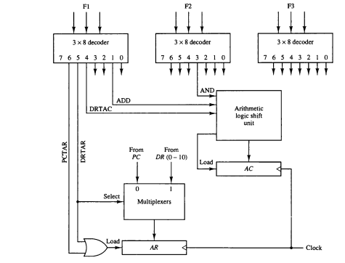
Design of Control Unit
Fig. Decoding of micro-operations fields

Slide 16
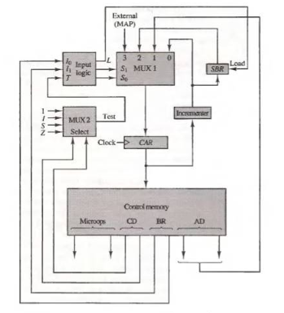
MICROPROGRAM SEQUENCER - NEXT MICROINSTRUCTION ADDRESS LOGIC -
Design of Control Unit
MUX-1 selects an address from one of four sources and routes it into a CAR
- In-Line Sequencing → CAR + 1
- Branch, Subroutine Call → CS(AD)‏
- Return from Subroutine → Output of SBR
- New Machine instruction → MAP

Slide 17
MICROPROGRAM SEQUENCER - CONDITION AND BRANCH CONTROL -
Design of Control Unit
From
CPU
1
Test
L
L(load SBR with PC) for subroutine Call
I
MUX2
T
S
BR field
of CS
Input
Z
Select
I₀
logic
S₀
S₁
for next address
selection
I₁
CD Field of CS
Input Logic
I₀I₁T Meaning Source of Address S₁S₀ L
000 In-Line CAR+1 00 0
001 JMP CS(AD) 10 0
010 In-Line CAR+1 00 0
011 CALL CS(AD) and SBR <- CAR+1 10 1
10x RET SBR 01 0
11x MAP DR(11-14) 11 0
S₀ = I₀
S₁ = I₀I₁ + I₀’T
L = I₀’I₁T

Slide 18
MICROINSTRUCTION FORMAT
Microinstruction Format
Information in a Microinstruction
- Control Information
- Sequencing Information
- Constant
Information which is useful when feeding into the system
These information needs to be organized in some way for
- Efficient use of the microinstruction bits
- Fast decoding
Field Encoding
- Encoding the microinstruction bits
- Encoding slows down the execution speed
due to the decoding delay
- Encoding also reduces the flexibility due to
the decoding hardware

Slide 19
HORIZONTAL AND VERTICAL MICROINSTRUCTION FORMAT
Microinstruction Format
Horizontal Microinstructions
Each bit directly controls each micro-operation or each control point
Horizontal implies a long microinstruction word
Advantages: Can control a variety of components operating in parallel.
--> Advantage of efficient hardware utilization
Disadvantages: Control word bits are not fully utilized
--> CS becomes large --> Costly
Vertical Microinstructions
A microinstruction format that is not horizontal
Vertical implies a short microinstruction word
Encoded Microinstruction fields
--> Needs decoding circuits for one or two levels of decoding
One-level decoding
Two-level decoding
Field A
Field B
Field A
Field B
2 bits
3 bits
2 bits
6 bits
2 x 4
3 x 8
2 x 4
6 x 64
Decoder
Decoder
Decoder
Decoder
1 of 4
1 of 8
Decoder and
selection logic

Slide 20
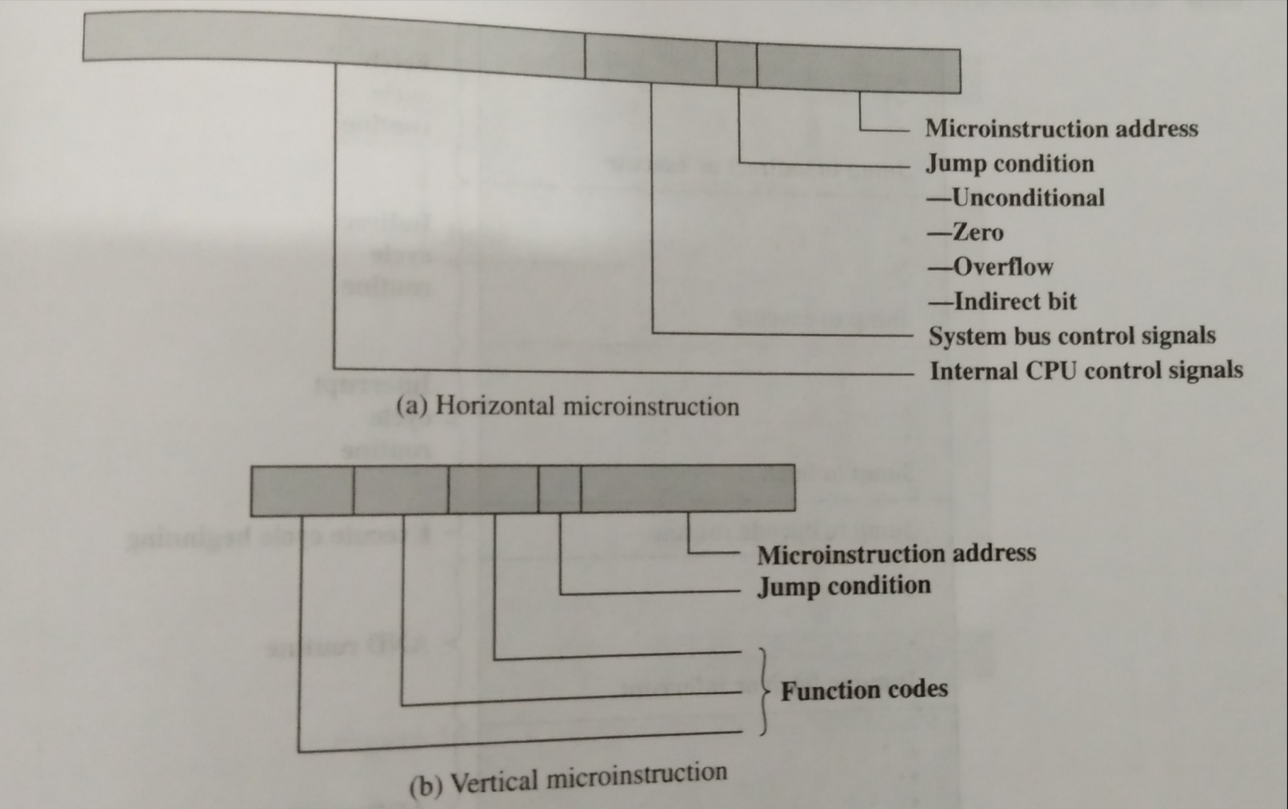
Fig: Horizontal and Vertical microinstruction

Slide 21
Horizontal microinstruction
To execute this microinstruction, turn on all the control line indicated by a 1bit; leave off all control lines indicating by a 0 bit. The resulting control signals will cause one or more micro operations to be performed.
If the condition indicated by the condition bits is false, execute the next microinstruction in sequence.
If the condition indicated by the condition bits is true, the next microinstruction to be executed is indicated in the address field.

Slide 22
NANOSTORAGE AND NANOINSTRUCTION
Control Storage Hierarchy
The decoder circuits in a vertical microprogram
storage organization can be replaced by a ROM
=> Two levels of control storage
First level - Control Storage
Second level - Nano Storage
Two-level microprogram
First level
-Vertical format Microprogram
Second level
-Horizontal format Nanoprogram
- Interprets the microinstruction fields, thus converts a vertical microinstruction format into a horizontal nanoinstruction format.
Usually, the microprogram consists of a large number of short microinstructions, while the nanoprogram contains fewer words with longer nanoinstructions.

Slide 23
TWO-LEVEL MICROPROGRAMMING - EXAMPLE
Control Storage Hierarchy
* Microprogram: 2048 microinstructions of 200 bits each
* With 1-Level Control Storage: 2048 x 200 = 409,600 bits
* Assumption:
256 distinct microinstructions among 2048
* With 2-Level Control Storage:
Nano Storage: 256 x 200 bits to store 256 distinct nanoinstructions
Control storage: 2048 x 8 bits
To address 256 nano storage locations 8 bits are needed
* Total 1-Level control storage: 409,600 bits
Total 2-Level control storage: 67,584 bits (256 x 200 + 2048 x 8)‏
Control address register
11 bits
Control memory
2048 x 8
Microinstruction (8 bits)‏
Nanomemory address
Nanomemory
256 x 200
Nanoinstructions (200 bits)‏

